Slide 1




Aplicación
Vitality Connect
Presentación final

Slide 2
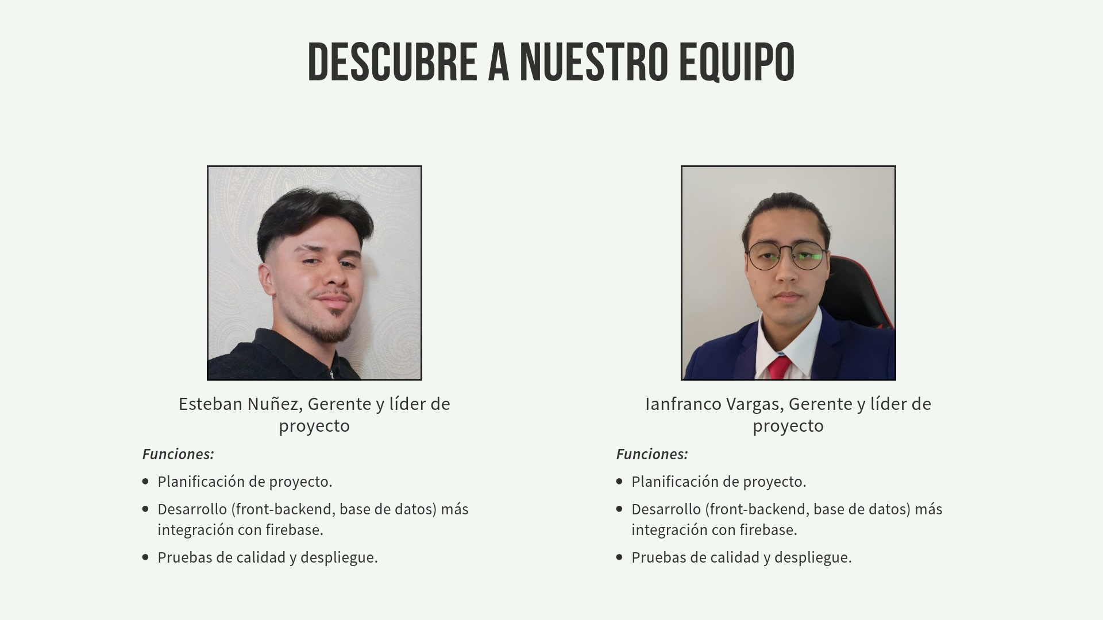
Vitality Connect

Slide 3
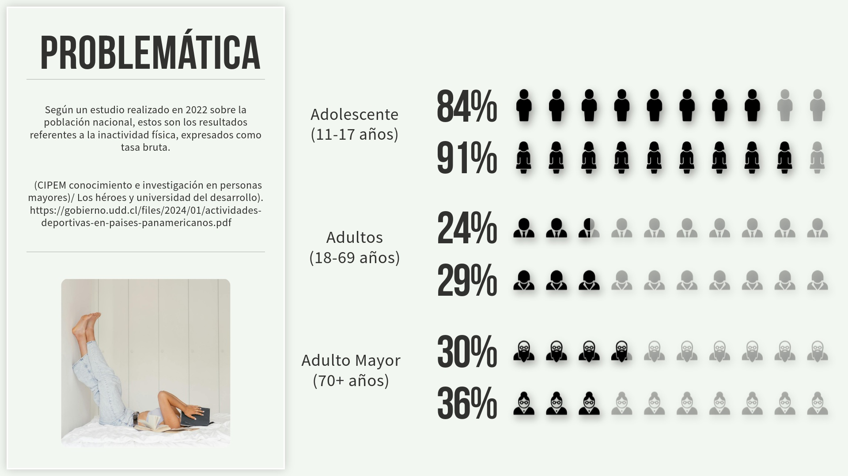
Vitality Connect

Slide 4
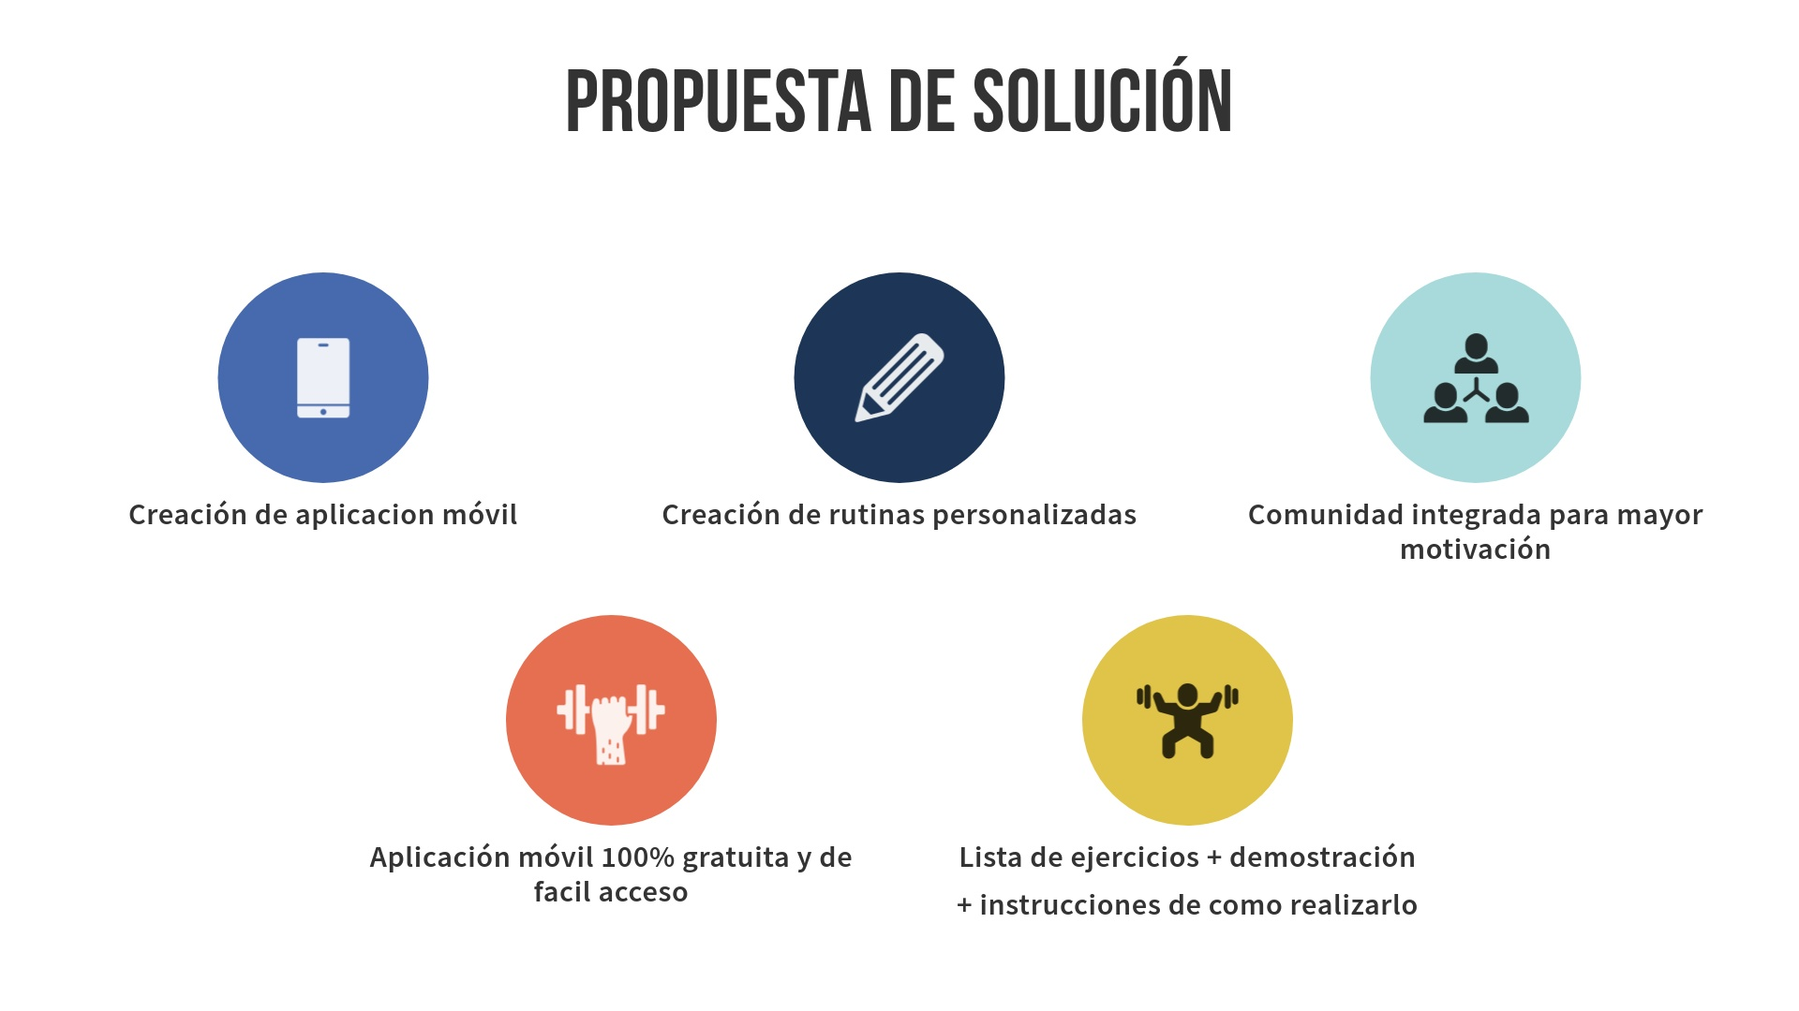
Vitality Connect

Slide 5
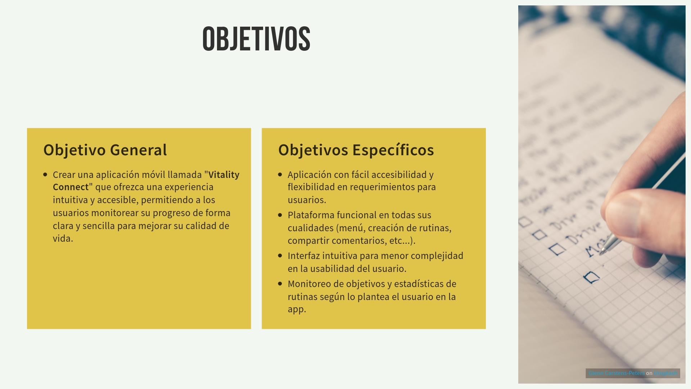
Vitality Connect

Slide 6
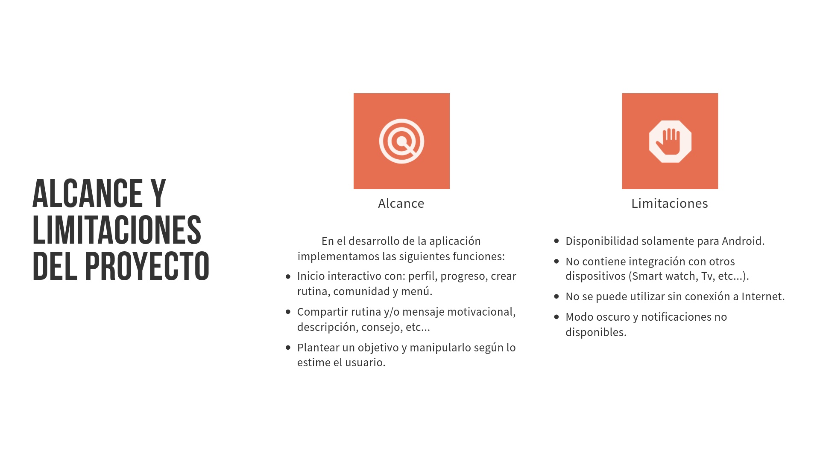
Vitality Connect

Slide 7
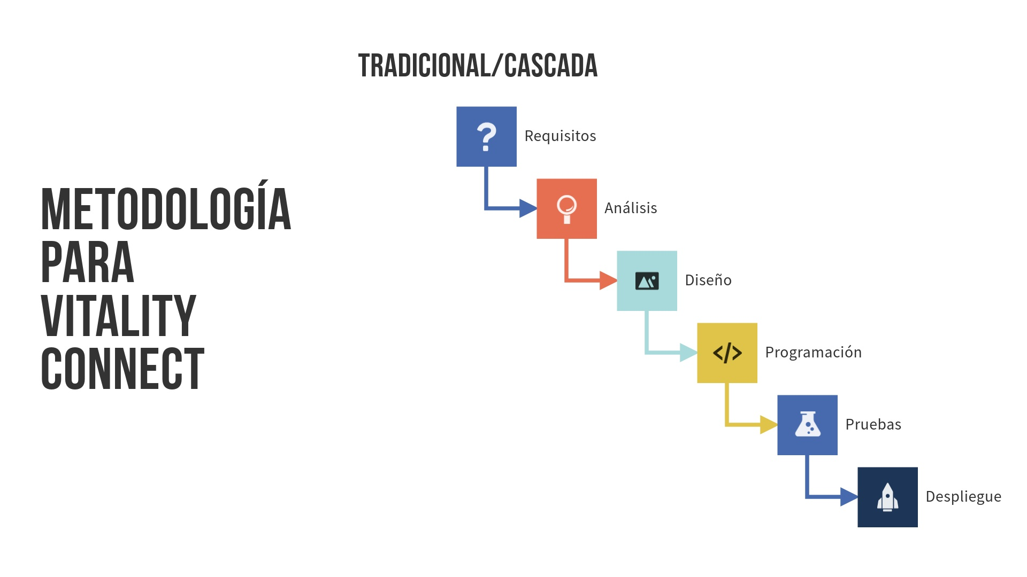
Vitality Connect

Slide 8
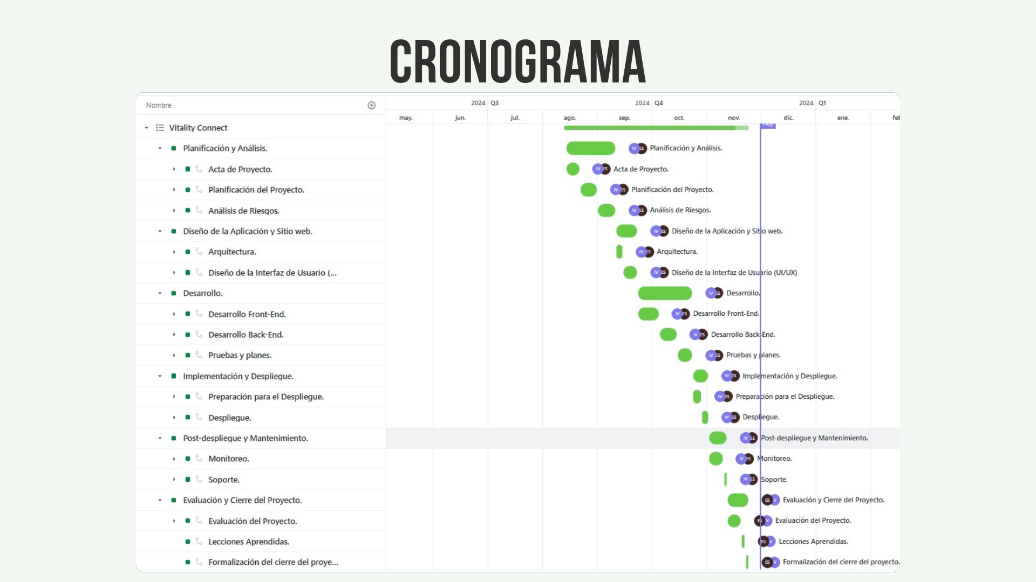
Vitality Connect

Slide 9
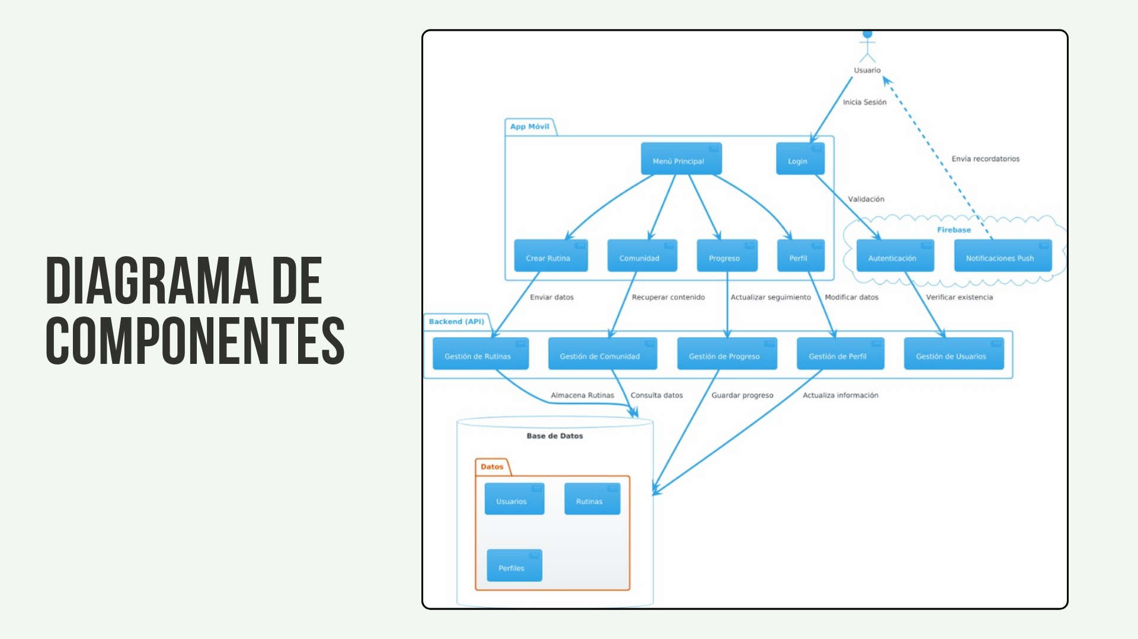
Vitality Connect

Slide 10
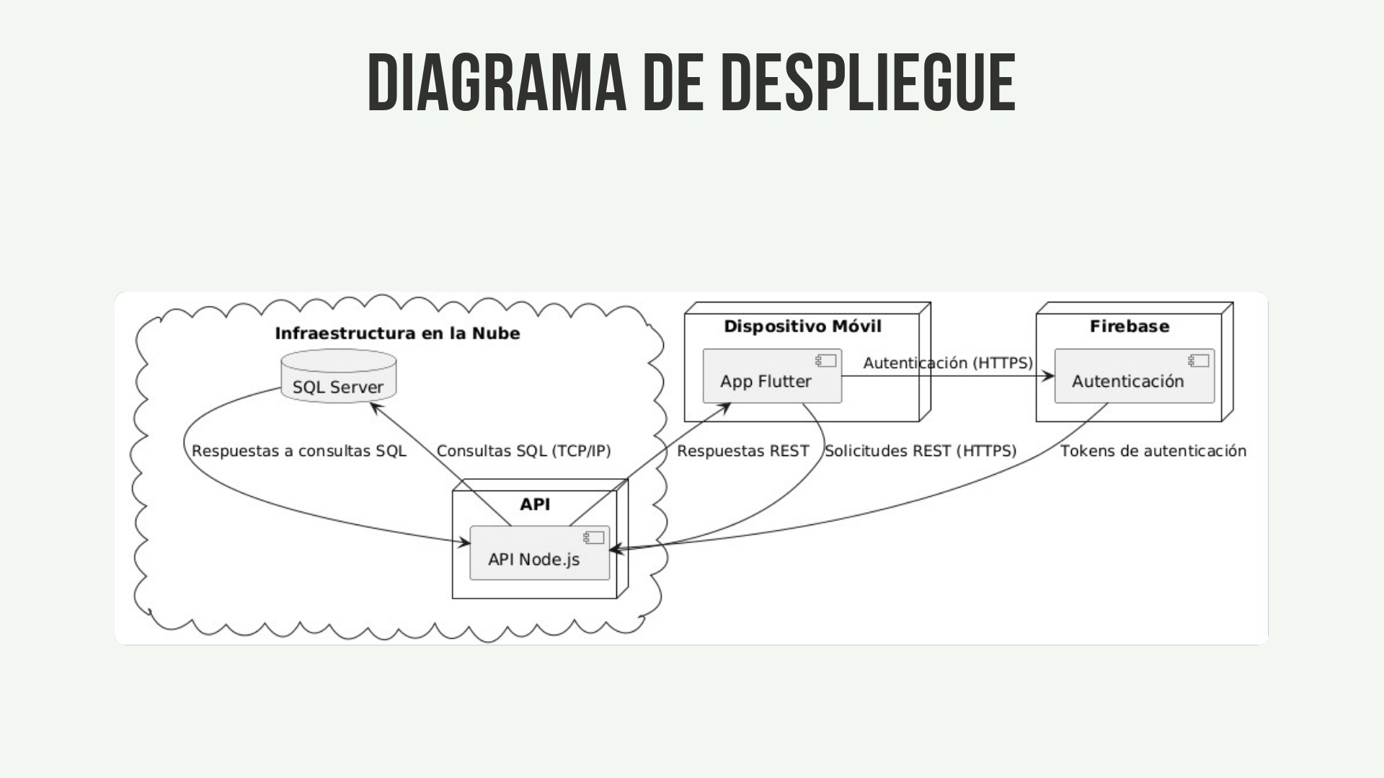
Vitality Connect

Slide 11
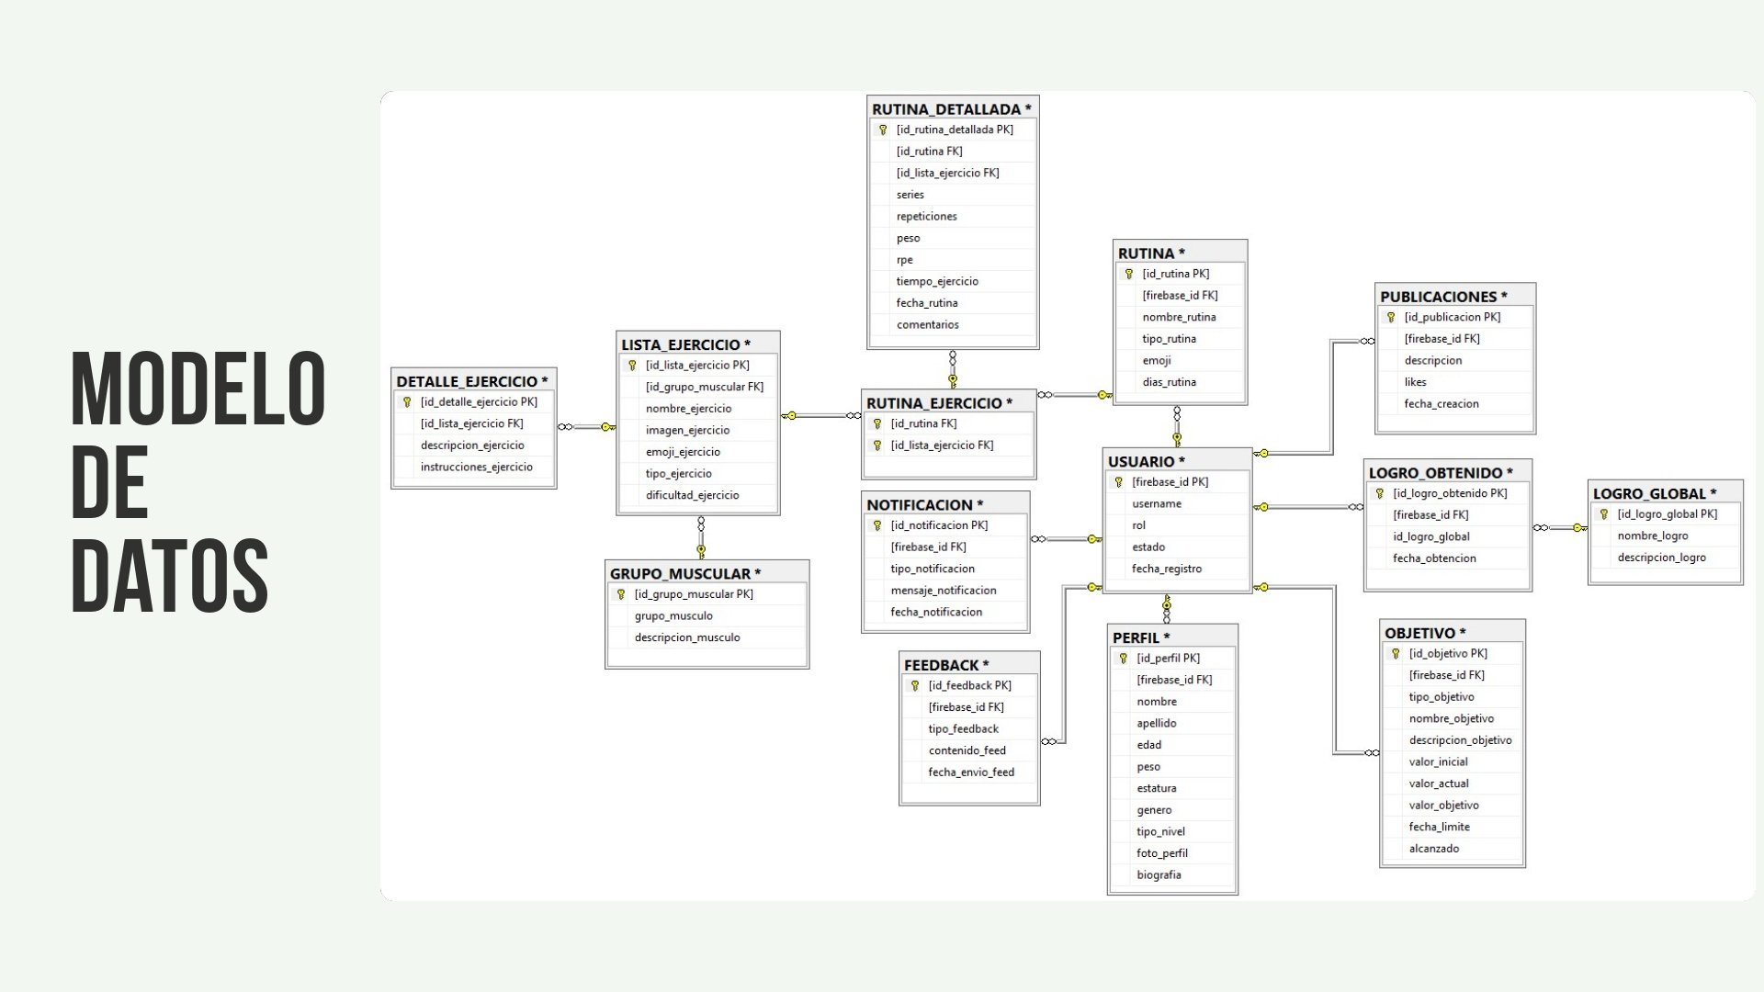
Vitality Connect

Slide 12
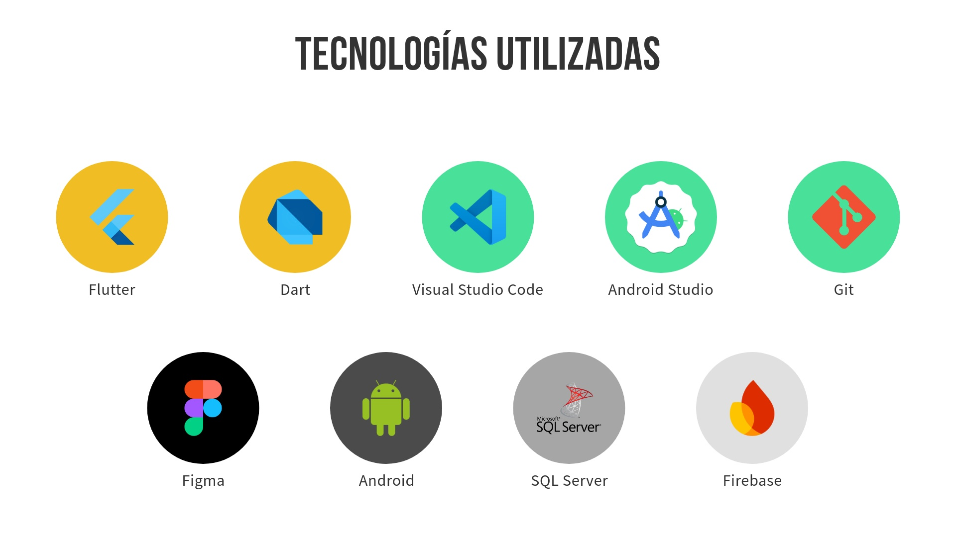
Vitality Connect
Desarrollo App
Herramientas de desarrollo
Prototipo
Plataforma
Base de datos
Backend

Slide 13
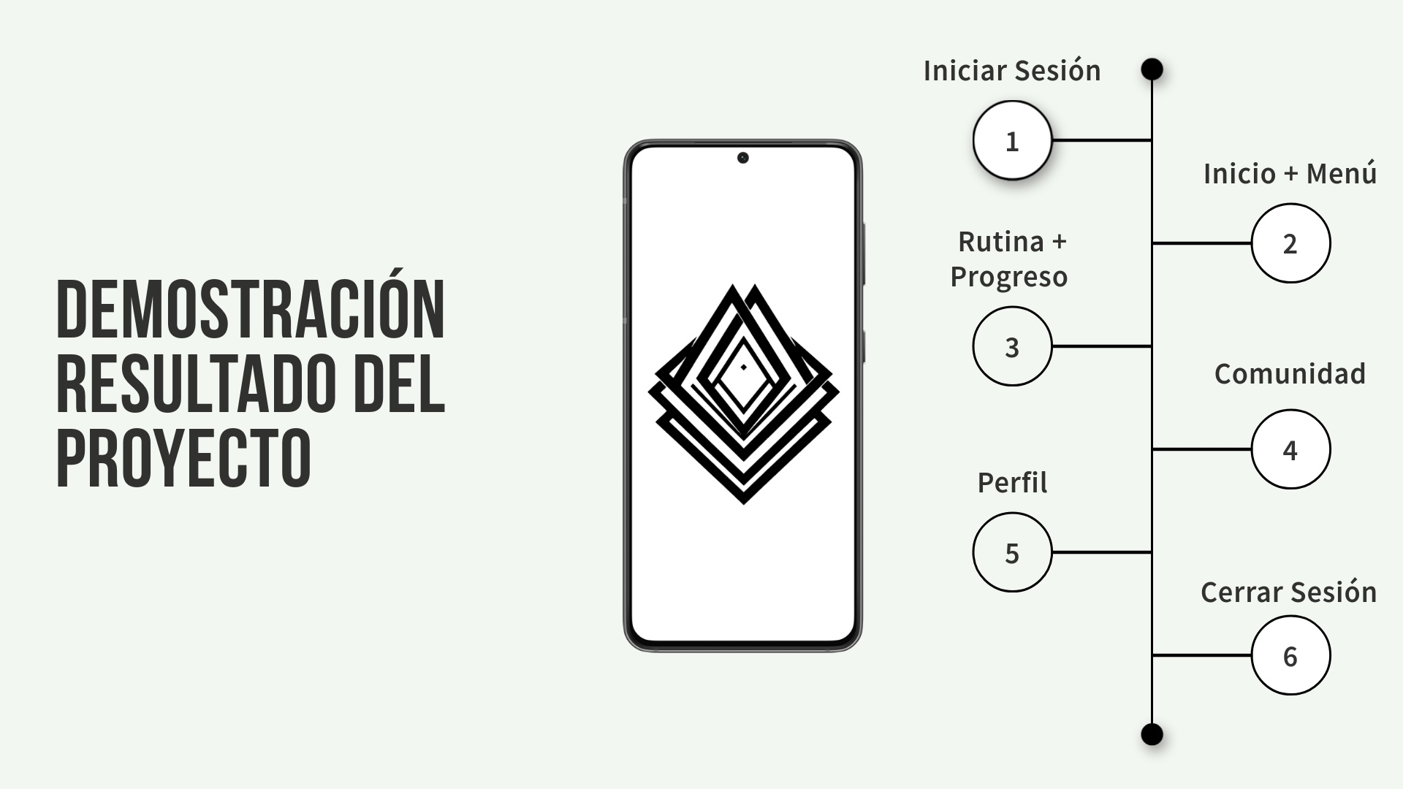
Vitality Connect

Slide 14
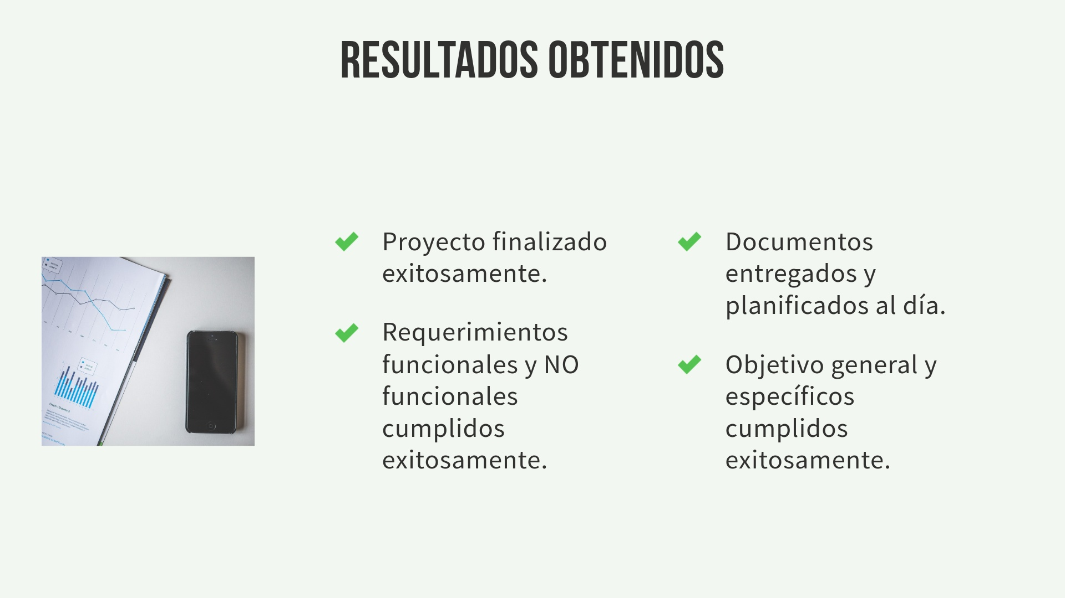
Vitality Connect

Slide 15
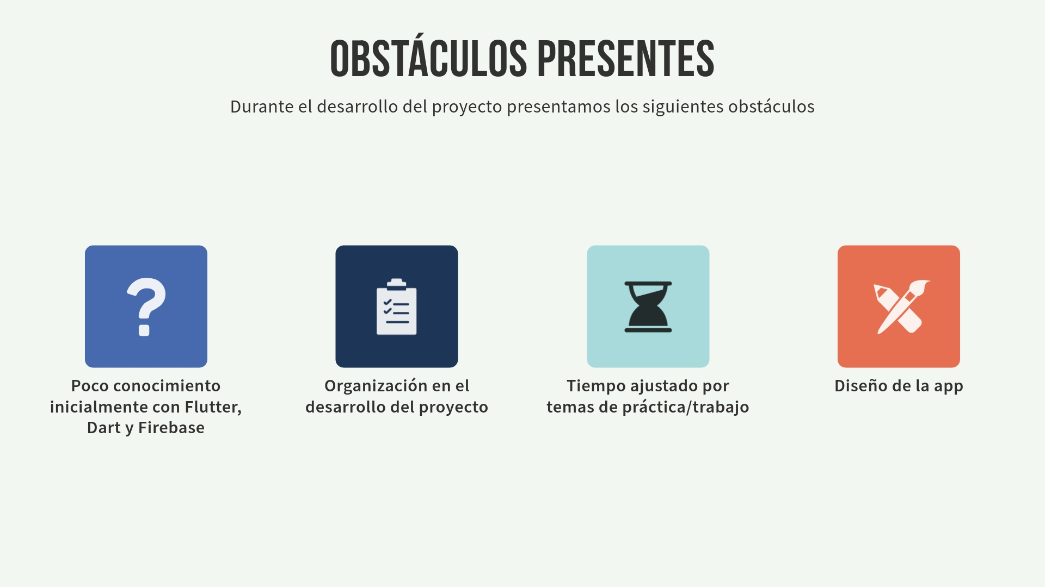
Vitality Connect

Slide 16

Vitality Connect

Slide 17
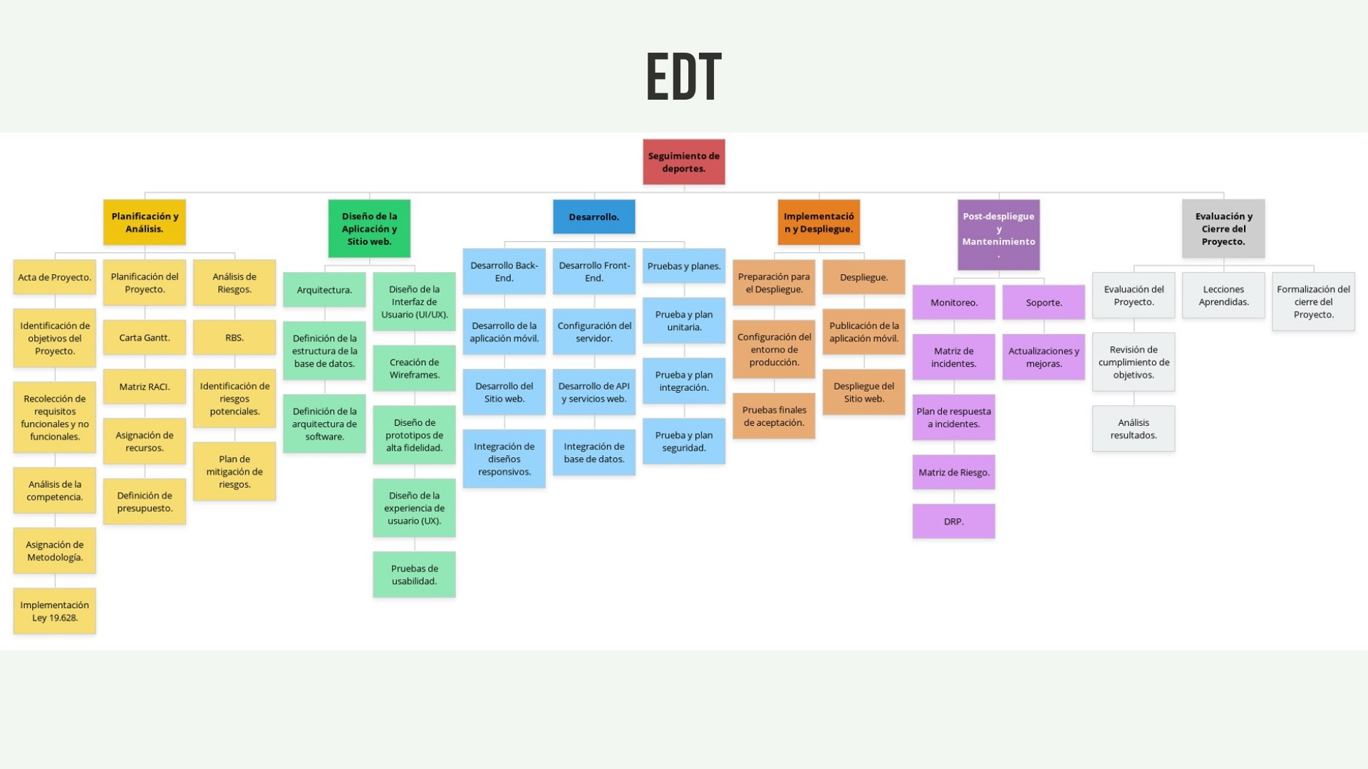
Vitality Connect

Slide 18
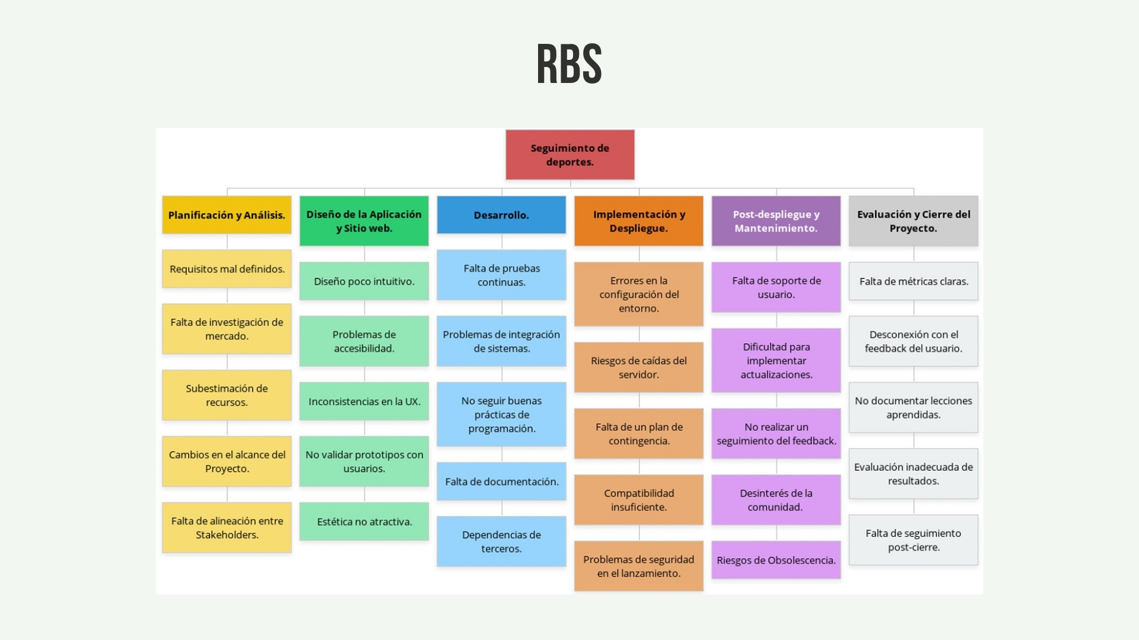
Vitality Connect

Slide 19
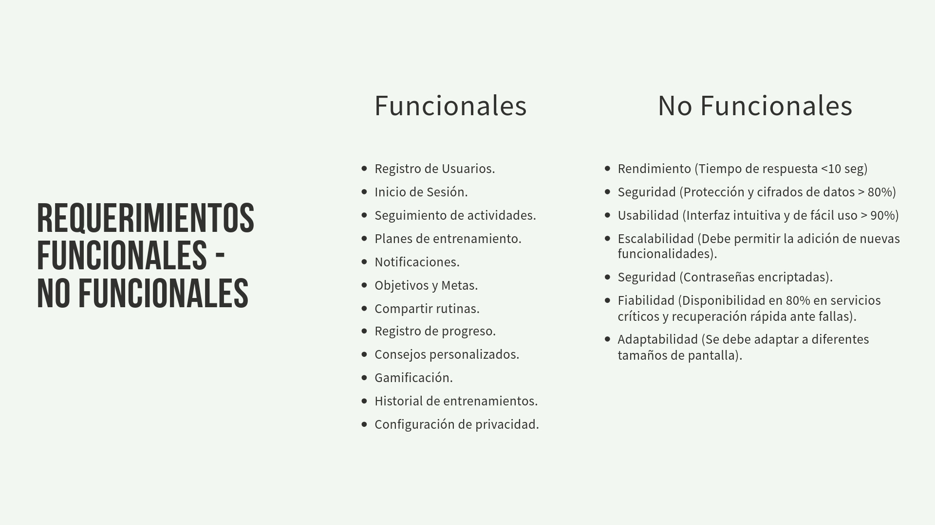
Vitality Connect

Slide 20
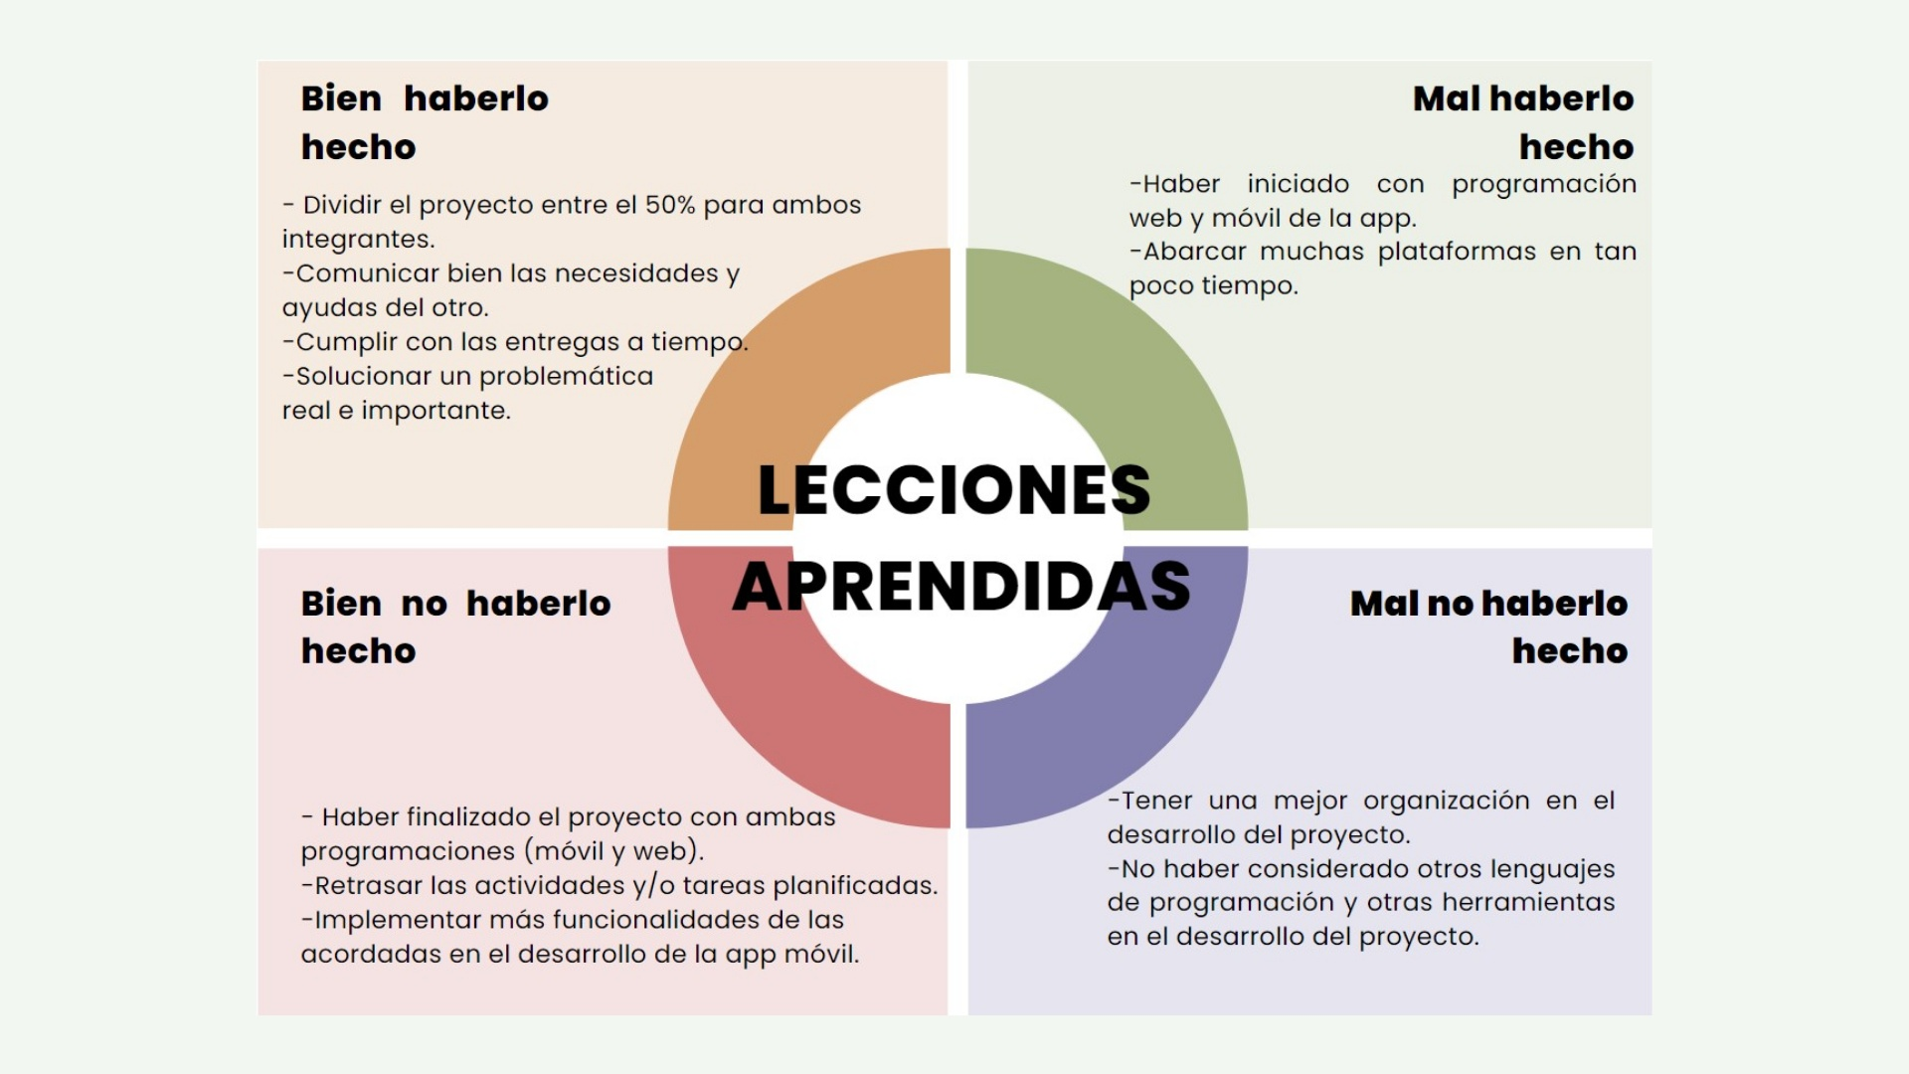
Vitality Connect

Slide 21
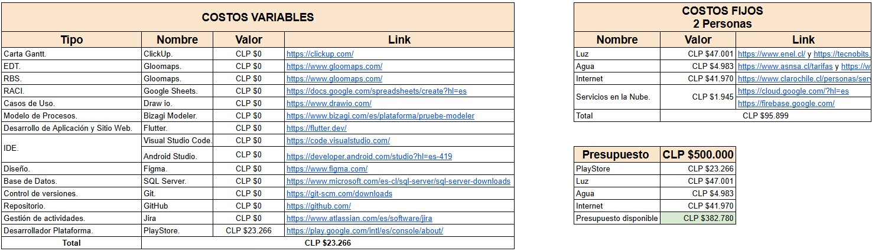
Vitality Connect
Presupuesto detallado

